Slide 1


Conversational Interface for Enhanced Online Shopping
Team Name: SPARTANS

Slide 2


Introduction
Today, we explore a groundbreaking solution designed to address the challenges that have persisted in the world of e-commerce. As technology advances, so does our commitment to providing users with an immersive, trustworthy, and enjoyable online shopping experience. Creating a direct chat feature with reviewers on e-commerce websites adds a personal touch to the shopping experience and can significantly enhance trust and information exchange.

Slide 3
The Heart of Our Solution
Conversational Interface Unveiled:
At the core of our solution lies a sophisticated conversational interface. Through natural language speech and text interaction, users can navigate seamlessly, gaining a real-world 'shopping feel' without leaving the comfort of their homes. This is particularly tailored to cater to the needs of the Indian market, where personal connections play a pivotal role in shopping decisions.

Slide 4
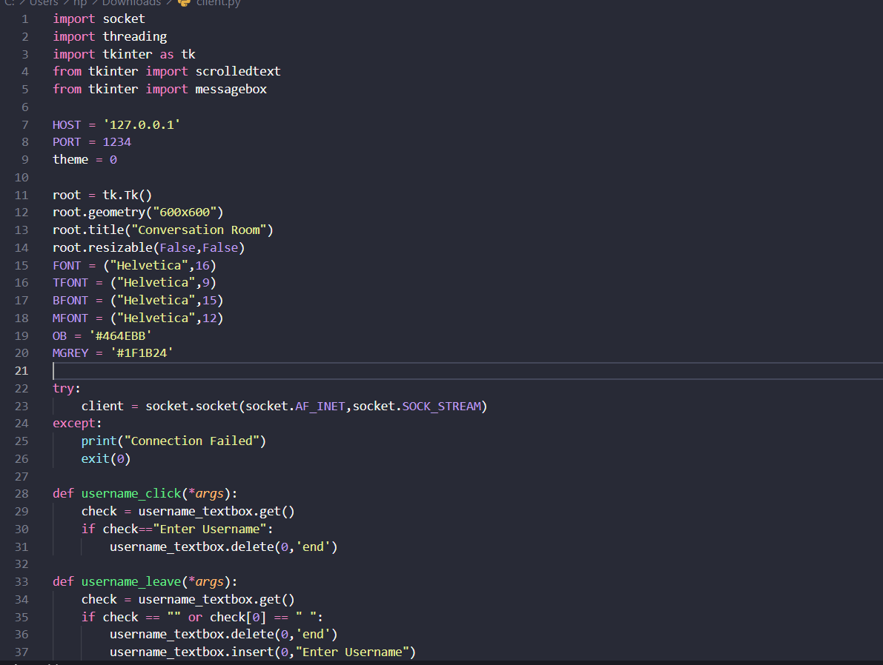
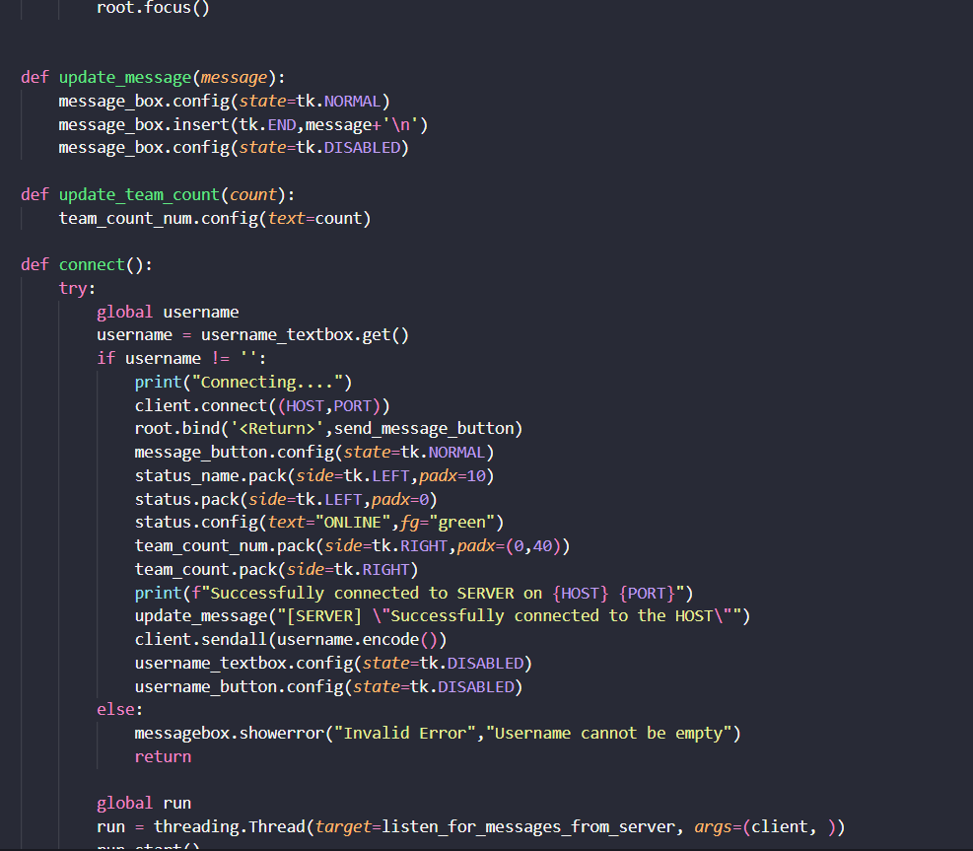
Implementation Details: Client side:

Slide 5
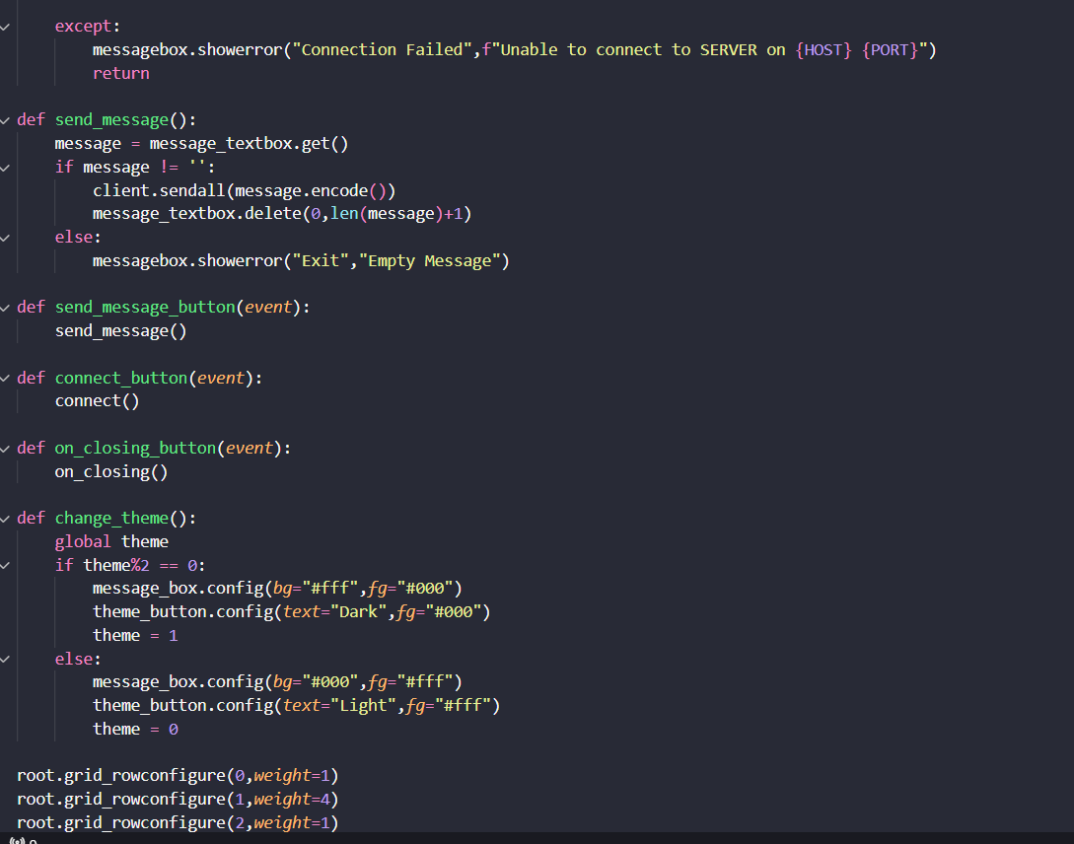
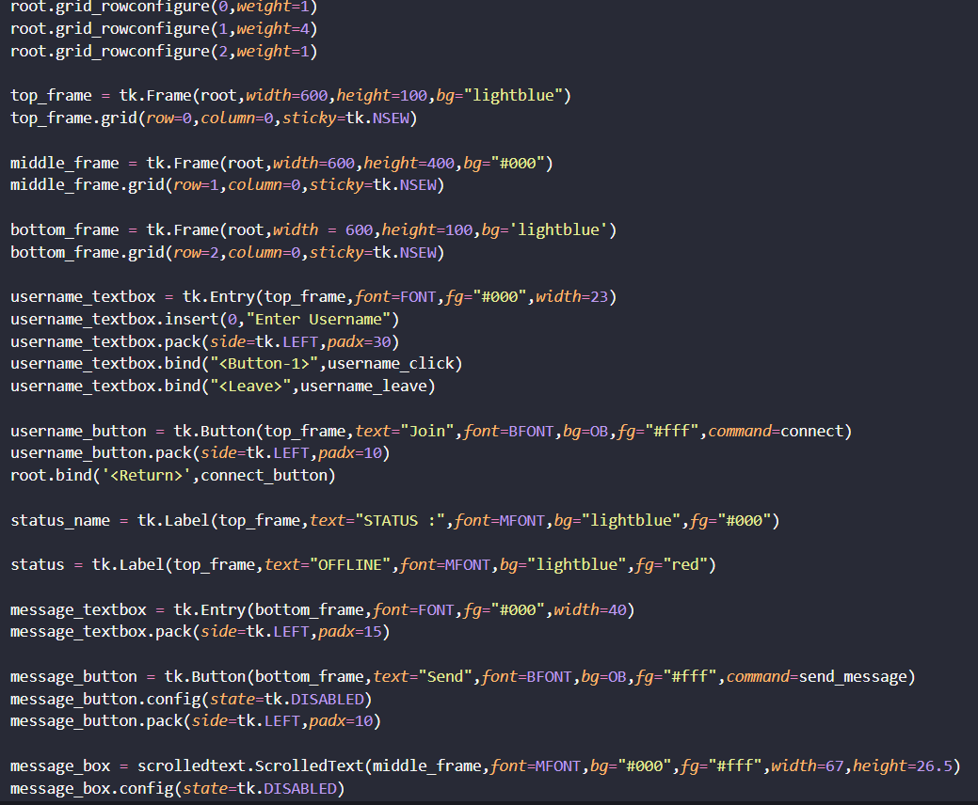

Slide 6
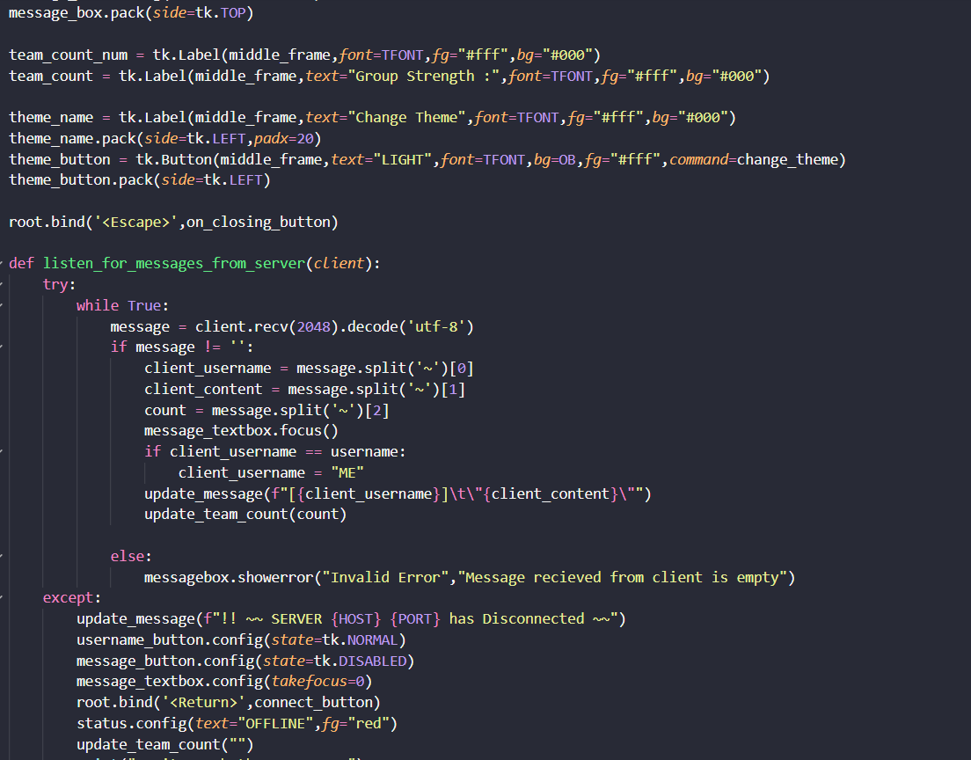
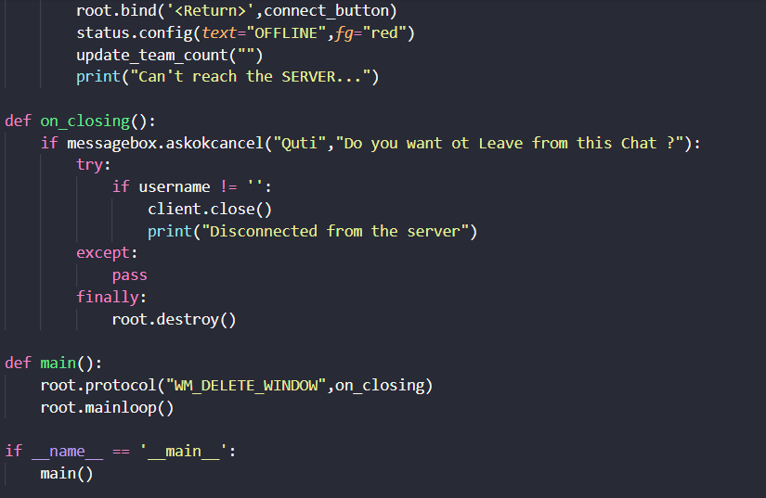

Slide 7
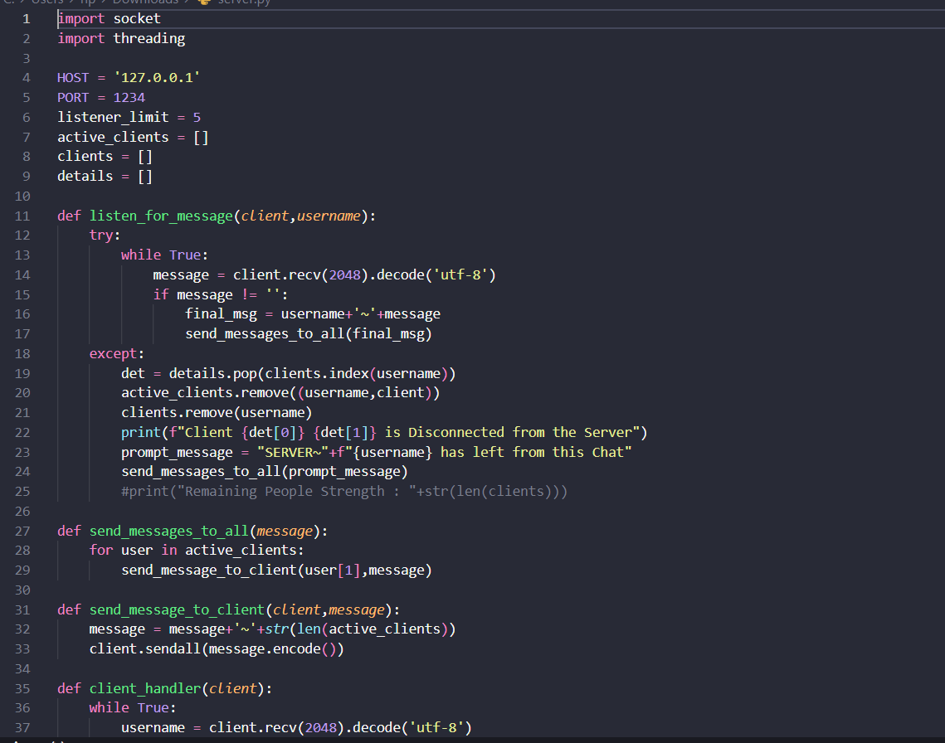
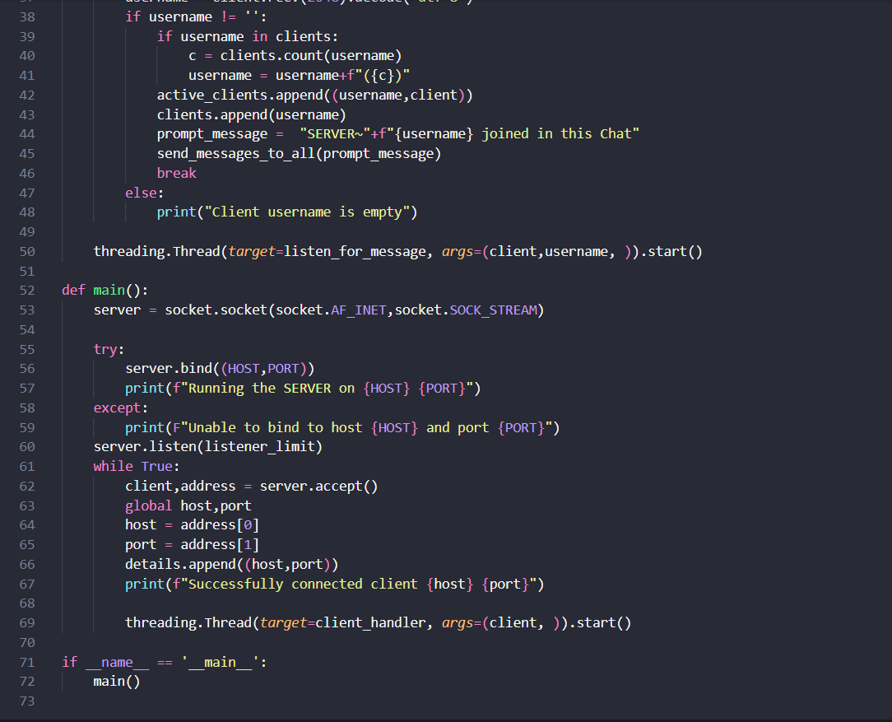
SERVER SIDE

Slide 8
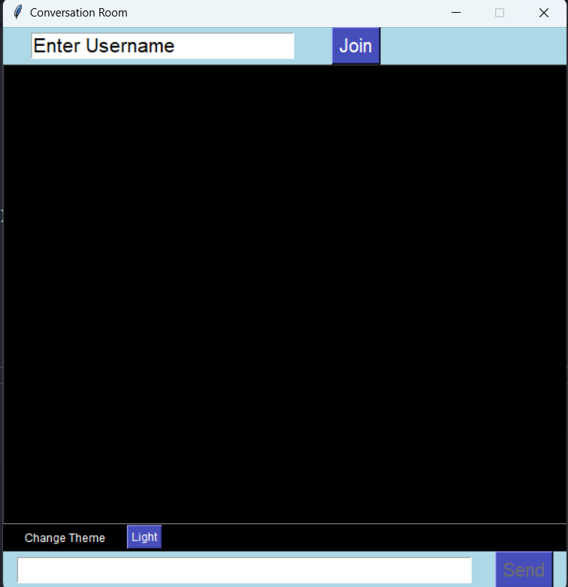
User Interface:

Slide 9
Conclusion:
In concluding our journey, we've witnessed the birth of a new era in online shopping. Through our conversational interface, we've dismantled barriers, fostered trust, and delivered an immersive experience. This is not just a solution; it's a transformation, bringing the personal touch of traditional shopping into the digital age.

Slide 10
Done by:
Balaji
Lakshitha
Ram Subramanian
Nithish selvam

